Slide 1

Political conditionality as EU foreign policy and crisis management tool. The case of EU wartime political conditionality vis-à-vis Ukraine
Maryna Rabinovych and Anne Pintsch
University of Agder, Norway
The article is part to the Research Council of Norway-funded project “Lowering the Bar? Compliance Negotiations and the EU-Ukraine Association Agreement” (grant number 315777)

Slide 2

Research idea
Challenge of the interplay between various EU foreign policy objectives (EUGS: self-interest and/vs normative considerations)
Objective: to investigate the compatibility between the EU’s political conditionality as a policy tool and the EU’s approach to conflict management, as rooted in the EUGS
Case: single case of the EU’s wartime application of conditionality vis-à-vis Ukraine
Case selection:
First-ever case of the EU’s application of political conditionality amidst a full-scale war in a target country
Illustrative of the evolving nexus between the EU’s conflict management and enlargement policies
Source: https://www.schumanassociates.com/newsroom/eu-external-investment-plan-opportunity-to-present-projects-open

Slide 3
Analytical approach
Two-step approach
Exploring the conceptual compatibility between political conditionality and three EUGS-rooted aspects of the EU’s approach to conflict management
Long-term approach
State and societal resilience and
Local ownership
Utilizing the case of the EU’s application of conditionality vis-à-vis Ukraine amidst Russia’s war against Ukraine to explore how the interplay between these features has worked in practice
Argument: conditionality is intertwined with the EU’s approach to crisis management but may bear conceptual contradictions with some of its aspects, such as societal resilience and local ownership

Slide 4
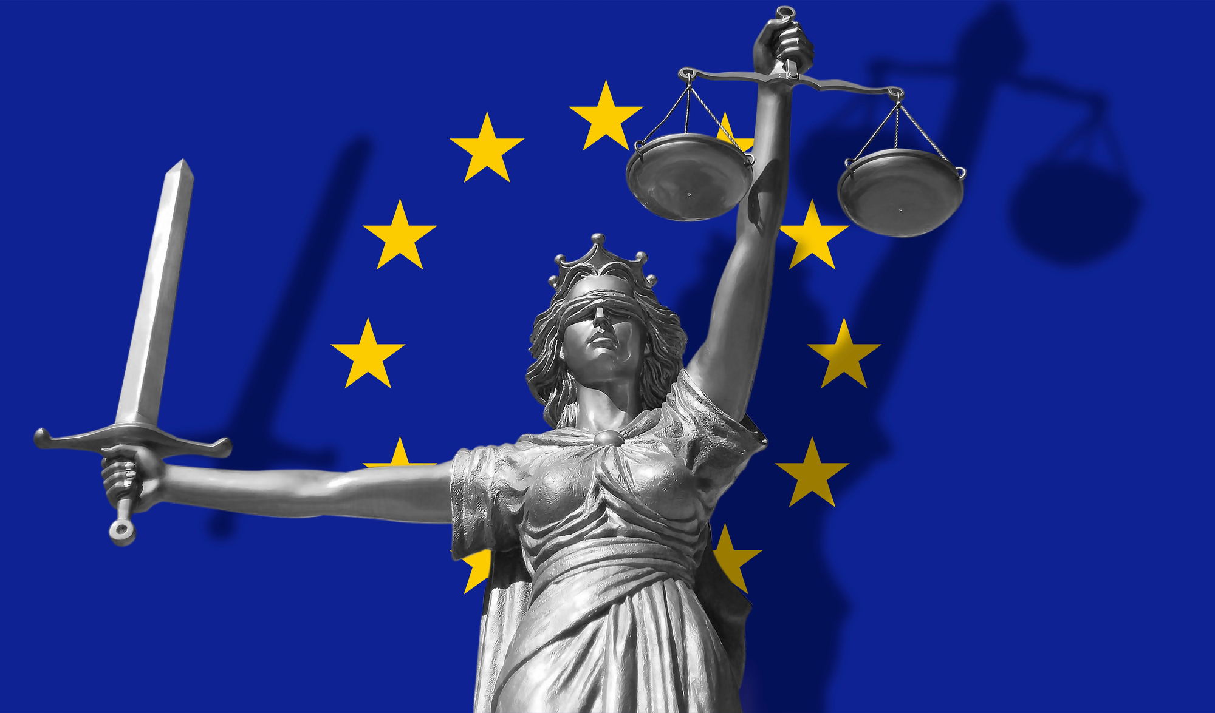
Political Conditionality
Centrality of political conditionality in the EU’s efforts to foster democratic transformation in third countries
Diversification of EU conditionality (ex- ante, ex-post, positive and negative conditionality)
“External incentives” and socialization models of ex-ante positive conditionality
Less frequently used models:
Ex-ante negative conditionality
Ex-post positive conditionality
Ex-post negative conditionality
Source: https://pathforeurope.eu/the-foreign-policy-dimension-of-the-rule-of-law-conditionality/

Slide 5

Relationship between conditionality and the IA features (based on literature)
Feature | Relationship with political conditionality
Long-term approach | Objective of achieving lasting peace and good governance Focus on the institutional and social strengths of partner countries as a basis for stable peace Offering considerable room for facilitating state and institutional development through ex-ante and ex-post conditionalities (the use of conditionality as a state-building tool in the Western Balkans)
Resilience and local ownership | Focus on the agency of a partner country Dichotomy between state and societal resilience Conditionality as a traditional tool for building state resilience Conceptual mismatch between the top-down conditionality logic and the notions of societal resilience and local ownership
Source: Diplomacy.edu

Slide 6
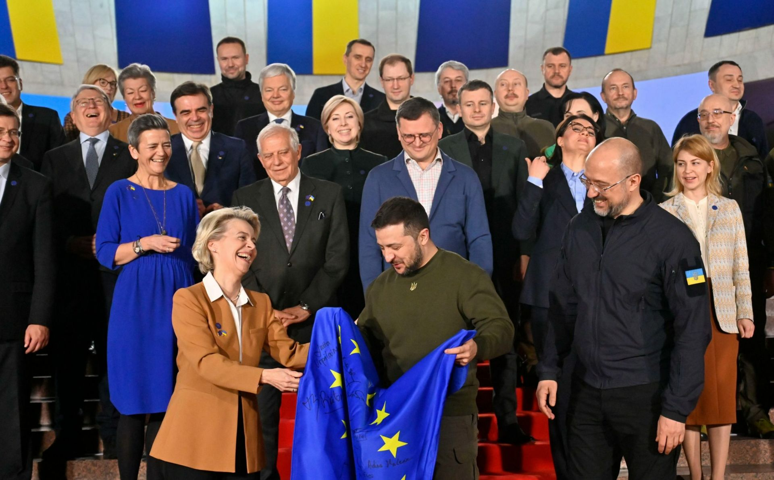
The Case of Ukraine: Setting the Scene
Three types of conditionality under study
Pre-accession conditionality. Seven conditions attached to the 2022 Commission’s Opinion on Ukraine’s application for EU membership + follow-up conditions in connection to the adoption of the negotiating framework
MFA-based conditionality. Political conditions, attached to the EU’s wartime macro-financial assistance (MFA) to Ukraine (2022-2023)
Recovery-related conditionality. Conditionality as part of the EU’s approach to supporting Ukraine’s post-war reconstruction + Ukraine Facility (2024-2027)
Source: EU Neighbours East

Slide 7
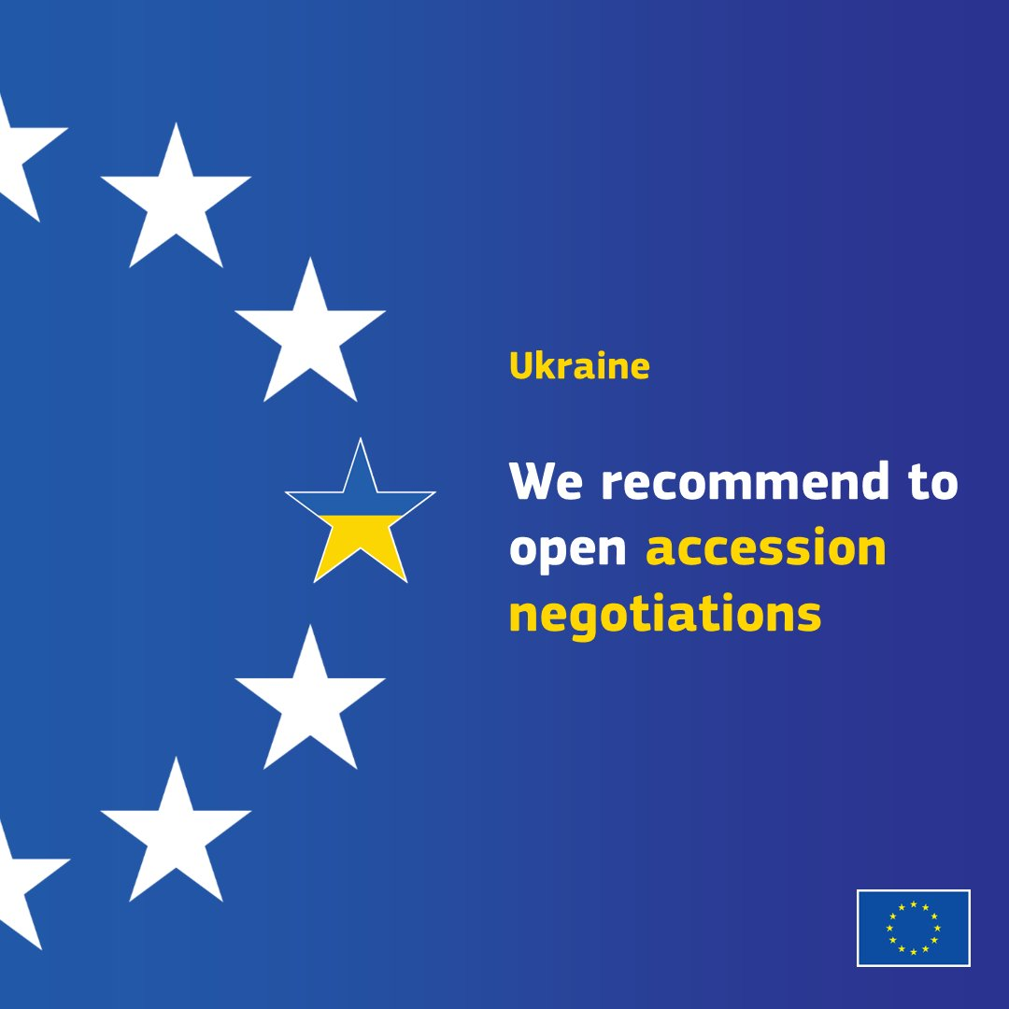
Pre-accession conditionality
“Integration through war” situation offering momentum to the EU’s application of conditionality vis-à-vis Ukraine
Seven conditions: focus on governance and resilience of state institutions
Fit with long-term approach (e.g. opportunity for follow-up conditions) but (!)
Differences in ex-ante conditionality’s potential to serve as a societal mobilization tool / advance societal resilience & local ownership (as exemplified by seven conditions & follow-ups)
Source: X (European Commission)

Slide 8
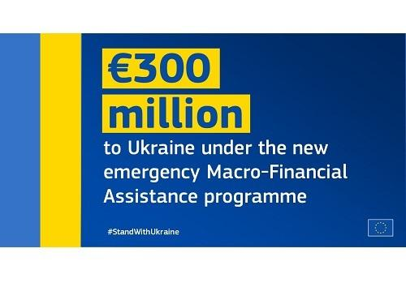
MFA-based conditionality (2022-2023)
MFA-based conditionality as complementary to the seven conditions in sensitive areas
A solely intergovernmental bargaining strategy, fitting the long-term approach and the ambition of building resilience of state institutions
Perceived domestically as a technical issue
Source: DG NEAR

Slide 9

Recovery-related conditionality (2024-2027)
Enlargement-recovery nexus in EU policy documents
Continuity of recovery efforts (no clear borderline between wartime / post-war recovery) matching the long-term approach
Broad room to promote the resilience of state institutions
Compatibility with the ownership principle – depends on implementation (NGOs’ involvement into the ‘making’ of a Ukraine Plan?)
Focus on societal resilience – oriented reforms / potential for societal mobilization under the Ukraine Facility:
Strong investment component (focus on businesses)
Decentralization
Source: DG NEAR

Slide 10
 | Long-term approach | Resilience of state institutions | Societal resilience | Local ownership
Pre-accession conditionality | Uncontested compatibility, given the duration of the enlargement process | Uncontested compatibility, opportunity to focus on specific institutions | Compatibility largely depends on the scope of conditionality and progress of both the war and enlargement process. Likely to deteriorate in the absence of tangible progress. | Compatibility largely depends on the design of a respective funding instrument and national procedures and practices for reform plans’ development and compliance monitoring
MFA-based conditionality | Compatibility depends on the EU’s complementary approach to conditionality and coordination with other instruments |  | Not compatible, focus on top-down logic and state institutions
Recovery-related conditionality | Uncontested compatibility, given the scale of recovery effort needed for Ukraine |  | Compatibility largely depends on the design of a respective funding instrument, Ukraine Plan – positive example | Compatibility largely depends on the design of a respective funding instrument and national procedures and practices for reform plans’ development and compliance monitoring
Summary of the findings based on the case of Ukraine

