Slide 1
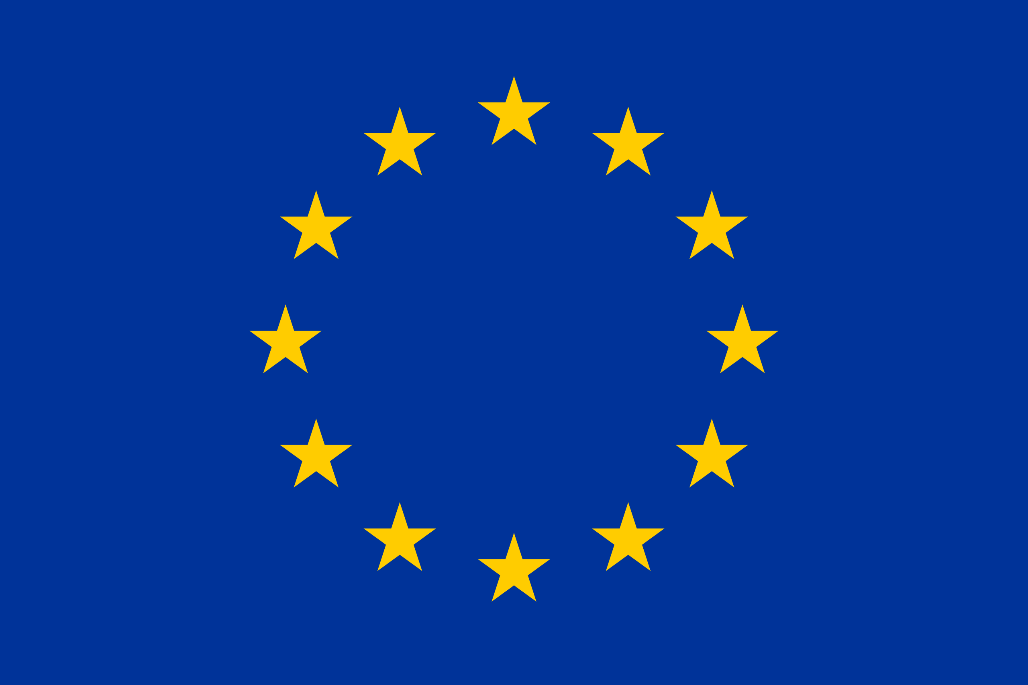

EU-Response to Russia’s War Against Ukraine: A Research Agenda
Maryna Rabinovych and Anne Pintsch
University of Agder

Slide 2
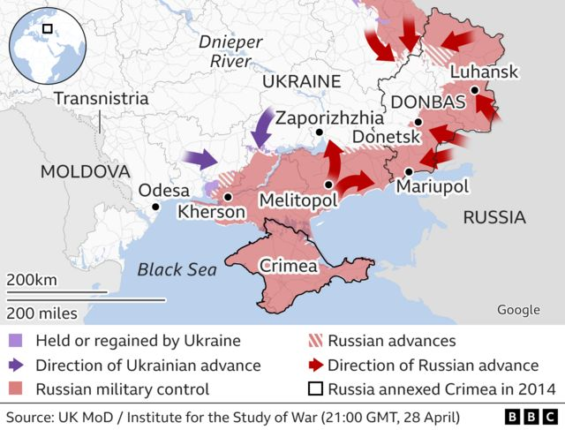
Contents
Several words about Russia’s war against Ukraine and why it is SO important
EU response to the war
Mapping the research agenda
Analyzing EU response through the “failing forward” framework: an example of developing one of the agenda’s directions
Your ideas?

Slide 3
Why is Russia’s war against Ukraine SO important? (1)
For Ukraine
Existential war, culminating the 400-year history of Russia-Ukraine standoff
War of the past against the future
Chance to counter the ‘security vacuum’ Ukraine is in and restore the country’s territorial integrity
Chance for Russia’s long-term weakening /regime change
For Russian regime
Ambition to change the post-Cold War world order through achieving hegemony in the post-Soviet space
Becoming ‘great again’
Achieving internal domination through selling “victory” to citizens
For Russia and Russian people
Chance for regime change and transformation through military loss and collective blame

Slide 4

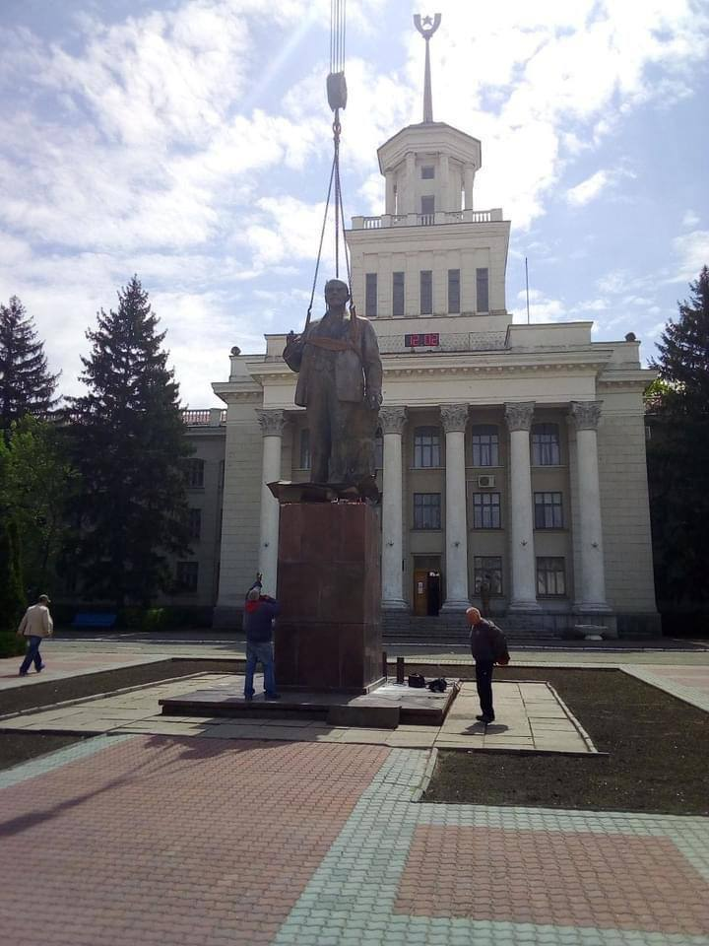
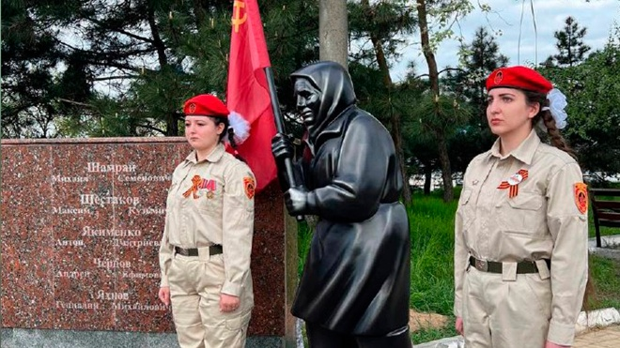
1.(up/left). Mariupol before and after Russian ‘liberators’. 2. (down/left) –monument with Soviet flag in Mariupol; 3. Lenin statue in occupied Novaya Kakhovka

Slide 5
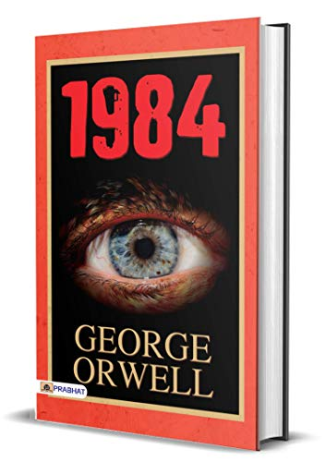
Why is Russia’s war against Ukraine SO important? (2)
For the West (and the EU specifically)
  Calling for new transatlantic unity (Anti-Putin coalition)
  Breaking stereotype that full-scale European war is no longer possible
  Profoundly challenging the global non-proliferation regime
  Revealing the need to take protection of values (and autocrats who challenge them) seriously
  Showing how dangerous resource dependence on autocrats is
  Challenge of autocrats’ creating their own unions (BRICS)
  Demonstrating the power of propaganda and post-truth
  Showcasing that post-modern agenda does not work for all and the geopoliticization of international cooperation (ENP/EaP)
  Challenge of holding a state responsible for war and prosecuting war criminals

Slide 6
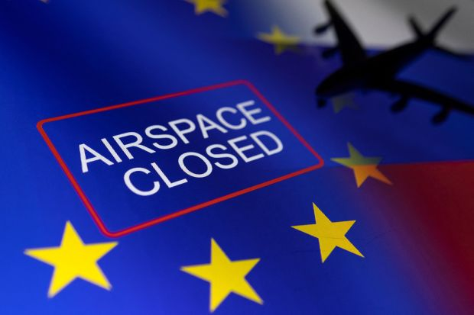
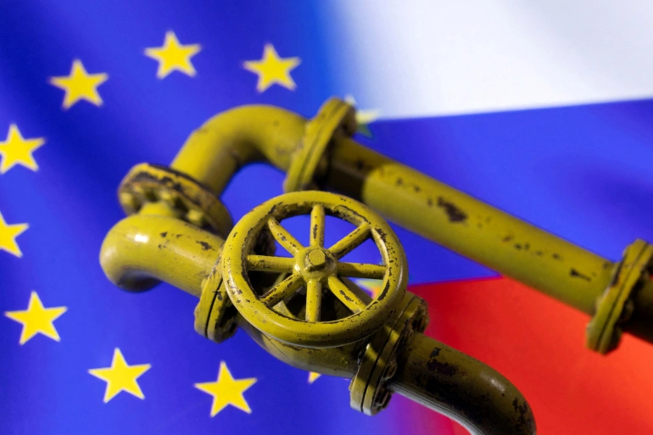
EU Response to War (1)
Political reactions, incl. calls from HR/VP to Member States to boost arm supplies to Ukraine, cancellation of visa facilitation benefits for Russian diplomats and officials and self-critique as to the dependency on Russian fossil fuels.
Six packages of sanctions, incl. ambitious sanctions against individuals, sanctions against Russian Central Bank, oil embargo, sanctions against media channels and ban for Russia-owned aircrafts to enter EU air-space.
Changes to internal policies, incl. Strategic Defense Compass, RePowerEU and common gas procurements
Source: AlJazeera

Slide 7
EU Response to War (2)
Unprecedented support to Ukraine
Political talks over granting Ukraine a membership perspective
Ukraine’s joining E-ENTSO network a year earlier than planned
One-year suspension of all import duties for Ukraine’s products
Deployment of the EU Peace Facility (1.5 bln EUR, first ever deployment to fund weapons for a third state)
Emergency macro-financial assistance package worth 1.2 bln EUR
Humanitarian assistance and relief supplies worth 93 million EUR
Setting up the Ukraine Solidarity Trust Fund
Temporary collective protection scheme for Ukrainian refugees (3.5 bln EUR pre-financing to Member States hosting Ukrainians (first ever activation of Temporary Protection Directive)
Visits of high-level EU officials, especially following the Bucha massacre in March 2022

Slide 8
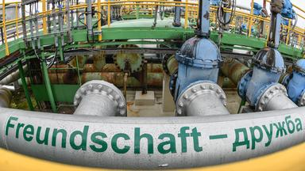
EU Response to War: What Shall We Study? (1)
The dynamics and challenges of Member States’ foreign policy cooperation
Continuity and change of specific Member States’ policies vis-a-vis Russia and Ukraine during the crisis (e.g. Germany, Austria)
EU’s Russia policy since the Euromaidan, i.e. EU’s insufficient involvement in oil and gas supplies’ issues / EU and the Nord Stream 2 project.
EU’s and Member States’ changing discourses as to energy dependency on Russia following the outbreak of the war (‘blame games and claiming credit’)
EU security actorness, transatlantic relations and the future of the ‘strategic autonomy’ concept
EU-UK relations in the context of the war

Slide 9
EU Response to War: What Shall We Study? (2)
EU – Ukraine association negotiations (compliance negotiations) turning into enlargement negotiations
Intra-EU debate about Ukraine’s ‘fast-track’ membership procedure
Oganizational theory perspectives on the EU response to war
Future of the European Neighbourhood Policy and Eastern Partnership
EU membership perspective negotiations with Moldova and Georgia
War’s implications for European integration

Slide 10
Analyzing EU response through the “failing forward” framework
Incomplete Governance Structures
Incomplete structures claim to be inadequate by some leaders
Incomplete governance structures produce functional spillovers and trigger crises
The cycle repeats itself
Framework developed as a response to the demand for developing and applying new synergetic frameworks to the research at the crossroads of EU foreign policy, differentiated integration and disintegration.
The framework shows how deeper integration results from a sequence of incomplete lowest common denominator bargaining outcomes, functional spillovers and crises they spark and, once again, incomplete outcomes of intergovernmental bargaining.
Two instances to consider: 2014 Ukraine crisis and 2022 war

Slide 11
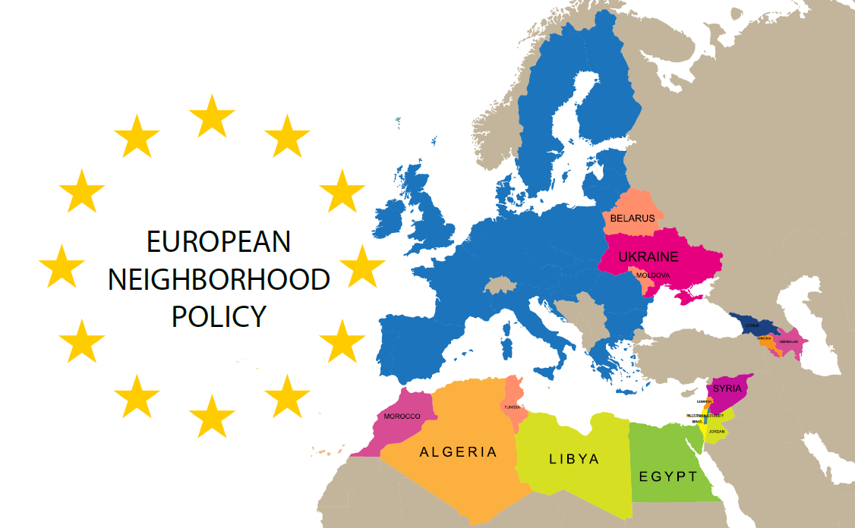
Initial policy incompleteness
Incomplete nature of the ENP at its birth
  Policy’s “development in a context where membership seemed less and less available for countries of the periphery” (Cadier, 2013)
  Absence of a membership perspective, despite an initially ambitious integration agenda
  On the other hand: policy’s ‘technocratization’ and ‘blindness’ to its geopolitical implications
  Though seeming to be mutually contradicting, both these aspects of policy incompleteness can be seen as resulting from the ‘lowest common denominator’ nature of the policy
    Leader’s concerns about policy incompleteness
    “Steady disillusionment” about stakeholder groups in partner countries

Slide 12

NF solutions as “polyurethane foam” for incomplete intergovernmental arrangements
2004-2007 action plans for Ukraine, Moldova and Georgia (“gradual approximation of norms & standards to the EU ones)
Eastern Partnership as a framework for the emergence of functional spillovers and the formation of supranational interest groups (among parliaments, civil society, business, youth)
The “depth” of the trade-related parts of the AAs
Dynamic nature of the Single Market (e.g. “Digital Single Market)
Multi-component institutional architecture under the AAs + the emergence of the “secondary association law”
Neighbours’ participation in the EU sectoral bodies and agencies (e.g. the European Food Safety Authority) + EU programmes (COSME, Horizon 2020)
Democracy promotion through functional cooperation (Freyburg, et al. 2011)
Unilateral financial and technical assistance

Slide 13
2014 Ukraine crisis
Challenge to apply the framework, as the crisis was largely sparked by 3rd party (Russia)
Evident linkage between the crisis and Ukraine’s European integration aspirations and ENP (Euromaidan)
Accusations of the West of having triggered the crisis

Slide 14

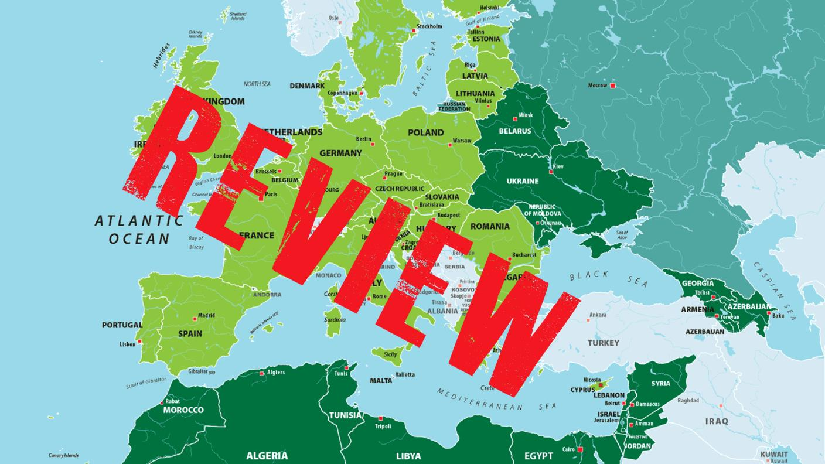
EU Crisis Response (new incomplete solution, roots for new crisis)
The crisis was addressed not through intergovernmental bargaining but a new wave of NF solutions
Key points:
The EU lowered its transformative ambitions vis-à-vis the Eastern Neighbourhood, drifting towards the policy’s geopoliticization and securitization
the EU’s response to the Ukraine crisis has encompassed three key aspects: sanctions against Russia; introducing the new principles in the relations with Russia and the intensification of cooperation with Ukraine.
No new intergovernmental outcomes, except sanctions against Russia.
Nonetheless, the EU crisis response was beneficial for Ukraine’s European integration and the advancement of resilience (Support Group for Ukraine at the Commission; sectoral reforms’ support; “reform positions” at the government)

Slide 15
Once again, crisis sparked by the 3rd party
Linkage to Ukraine’s European aspirations
Multi-aspect impact on the EU
2022 War

Slide 16

Quo Vadis?
As we see from the substance of the EU response to crisis, the EU already “failed forward” in the war context, inter alia, via intergovernmental solutions (on new sanctions, joint gas buying)
But how far will it “fail forward” or fail when it comes to enlargement and recalibrating its policy vis-à-vis Eastern Neighbours?
What else cam be researched and how to improve the scholarly take on the EU response to Russia’s war against Ukraine?

